Slide 1
Optics
Chap-09

Slide 2
Nature of light
Earlier, light was considered to be that form of radiant energy which makes objects visible due to stimulation of retina of the eye
It is a form of energy that propagates in the presence or absence of a medium, which we now call waves.
it was proved that these are electromagnetic (EM) waves. Later, using quantum theory, particle nature of light was established
According to this, photons are energy carrier particles.
it is now an established fact that light possesses dual nature
In vacuum, these waves (or photons) travel with a speed of c = 299792458 ms⁻¹
According to Einstein’s special theory of relativity, this is the maximum possible speed for any object.

Slide 3
Category of phenomena concerning light
Ray optics or geometrical optics: A particular direction of propagation of energy from a source of light is called a ray of light.
We use ray optics for understanding phenomena like reflection, refraction, double refraction, total internal reflection, etc.
Wave optics or physical optics: For explaining phenomena like interference, diffraction, polarization, Doppler effect, etc., we consider light energy to be in the form of EM waves.
Particle nature of light: Phenomena like photoelectric effect, emission of spectral lines, Compton effect, etc. cannot be explained by using classical wave theory
These involve the interaction of light with matter
For such phenomena we have to use quantum nature of light

Slide 4

Ray optics or geometrical optics
In geometrical optics, we mainly study image formation by mirrors, lenses and prisms
It is based on four fundamental laws/ principles
Light travels in a straight line in a homogeneous and isotropic medium.
Two or more rays can intersect at a point without affecting their paths beyond that point.
Laws of reflection:
Reflected ray lies in the plane formed by incident ray and the normal drawn at the point of incidence and the two rays are on either side of the normal.
Angles of incidence and reflection are equal.
4) Laws of refraction: These apply at the boundary between two media
Refracted ray lies in the plane formed by incident ray and the normal drawn at the point of incidence; and the two rays are on either side of the normal
Angle of incidence and angle of refraction are related by Snell’s law, given by, $n_{1}$ sin(i) = $n_{2}sin(r)$

Slide 5
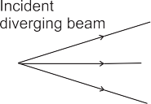

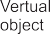
Criteria to draw ray diagram
All distances are measured from the optical center or pole. For most of the optical objects such as spherical mirrors, thin lenses, etc., the optical centers coincides with their geometrical centers
Figures should be drawn in such a way that the incident rays travel from left to right
A diverging beam of incident rays corresponds to a real point object as shown in first fig
a converging beam of incident rays corresponds to a virtual object
a parallel beam corresponds to an object at infinity
Thus, a real object should be shown to the left of pole and virtual object or image to the right of pole as shown in fig.

Slide 6
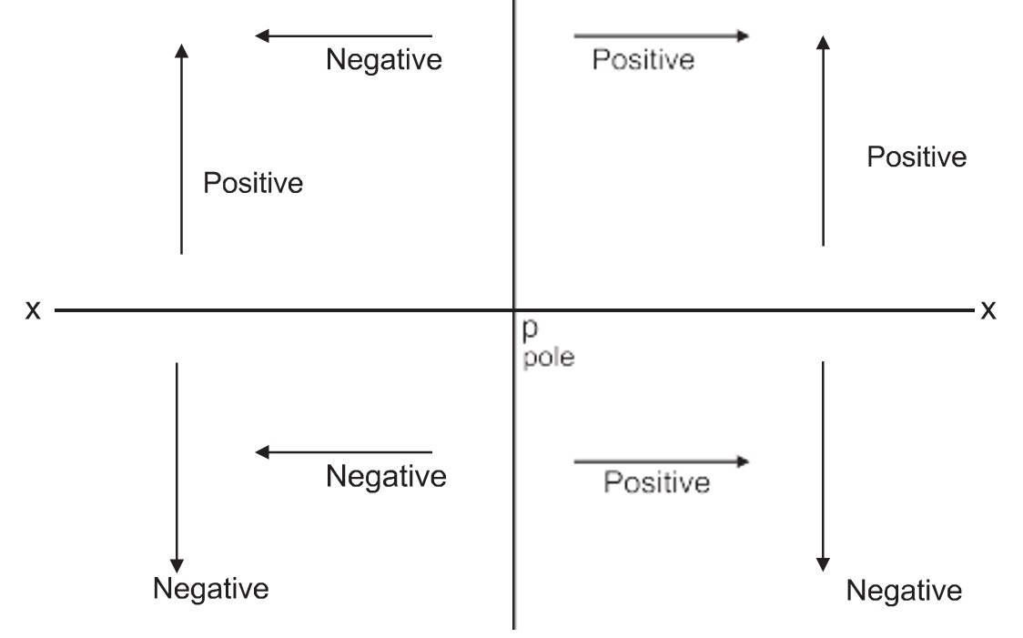
sign convention
Most convenient sign convention for ray optics is Cartesian sign convention as it is analogous to coordinate geometry
According to this sign convention as shown in fig.
x-axis can be conveniently chosen as the principal axis with origin at the pole
Distances to the left of the pole are negative and those to the right of the pole are positive
Distances above the principal axis (x-axis) are positive while those below it are negative

Slide 7

Reflection from a plane surface
If the object is in front of a plane reflecting surface, the image is virtual and laterally inverted. It is of the same size as that of the object and at the same distance as that of object but on the other side of the reflecting surface
If we are standing on the bank of a still water body and look for our image formed by water (or if we are standing on a plane mirror and look for our image formed by the mirror), the image is laterally reversed, of the same size and on the other side
If an object is kept between two plane mirrors inclined at an angle $θ$ , a number of images are formed due to multiple reflections from both the mirrors. Exact number of images depends upon the angle between the mirrors and where exactly the object is kept. It can be obtained as follows n = $\frac{360}{θ}$
Let N be the number of images seen
If n is an even integer, N = (n -1), irrespective of where the object is
If n is an odd integer and object is exactly on the angle bisector, N = (n -1)
If n is an odd integer and object is off the angle bisector, N = n
If n is not an integer, N = m, where m is integral part of n

Slide 8


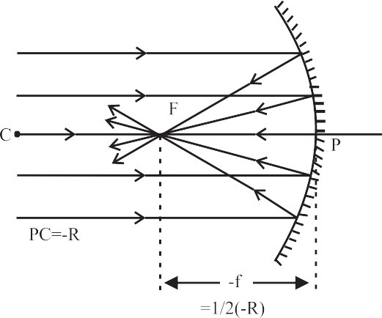
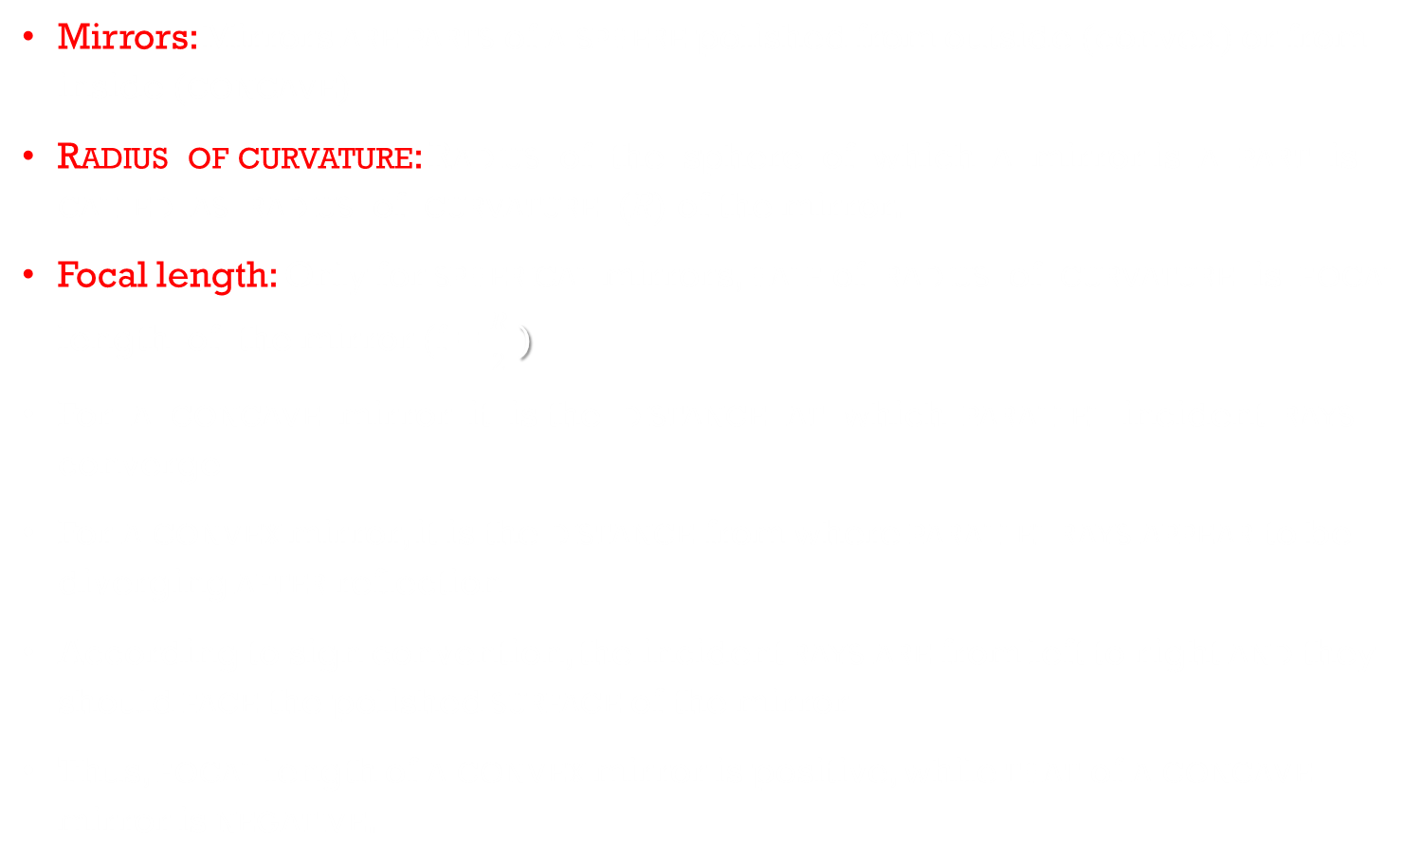
Reflection from curved mirrors
Mirrors: Mirrors are parts of a sphere polished from outside (convex) or from inside (concave)
Radius of curvature: Radius of the sphere of which a mirror is a part is called as radius of curvature (R) of the mirror.
Focal length: Only for spherical mirrors, half of radius of curvature is focal length of the mirror (f = $\frac{R}{2}$ )
For a concave mirror it is the distance at which parallel incident rays converge
For a convex mirror, it is the distance from where parallel rays appear to be diverging after reflection
According to sign convention, the incident rays are from left to right and they should face the polished surface of the mirror
Thus, focal length of a convex mirror is positive, while that of a concave mirror is negative.

Slide 9

Relation between f, u and v
For a point object or for a small finite object, the focal length of a small spherical (concave or convex) mirror is related to object distance and image distance as $\frac{1}{f}=\frac{1}{u}+\frac{1}{V}$
Focal power: Converging or diverging ability of a lens or of a mirror is defined as its focal power i.e. P = $\frac{1}{f}$ .
Lateral magnification: Ratio of linear size of an image to that of the object, measured perpendicular to the principal axis, is defined as the lateral magnification m = $\frac{v}{u}$

Slide 10
Image formation due to concave and convex mirror
Concave mirror (f negative)
Position of object | Position of image | Real(R) or Virtual (V) | Lateral magnifi- -cation
u = ¥ | v = f | R | m = 0
u > 2 f | 2 f > v > f | R | m < 1
u = 2f | v = 2f | R | m = 1
2 f > u > f | v > 2 f | R | m > 1
u = f | v = | R | m =
u < f | v > u | V | m > 1
S. No | Position Of Object | Position of Image | Size of Image | Nature of Image
1 | At Infinity | At the focus F, behind the mirror | Highly diminished | Virtual and Erect
2 | Between Infinity and the Pole | Between P and F, behind the mirror | Diminished | Virtual and Erect

Slide 11

Defects or aberration of images
The theory of image formation by mirrors or lenses, and the formulae that we have used such as f = $\frac{R}{2}$or $\frac{1}{f}=\frac{1}{u}+\frac{1}{V}$ etc. are based on the following assumptions.
Objects and images are situated close to the principal axis
Rays diverging from the objects are confined to a cone of very small angle
If there is a parallel beam of rays, it is paraxial, i.e., parallel and close to the principal axis
However, in reality, these assumptions do not always hold good
Commonly occurring defects are spherical aberration, coma, astigmatism, curvature, distortion.

Slide 12
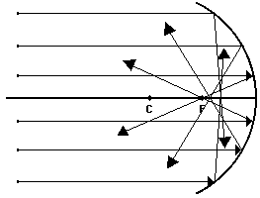
Spherical aberration
As mentioned earlier, the relation f=R/2, giving a single point focus is applicable only for small aperture spherical mirrors and for paraxial rays.
when the rays are farther from the principal axis, the focus gradually shifts towards pole
This phenomenon (defect) arises due to spherical shape of the reflecting surface, hence called as spherical aberration
It results into a unsharp (fuzzy) image with unclear boundaries The distance between both the focal point is measured as the longitudinal spherical aberration
If there is no spherical aberration, we get a single point image on a screen placed perpendicular to the principal axis at that location, for a beam of incident rays parallel to the axis
In the presence of spherical aberration, no such point is possible at any position of the screen and the image is always a circle
At a particular location of the screen, the diameter of this circle is minimum
This is called the circle of least confusion
In the figures it is across AB. Radius of this circle is transverse spherical aberration
In the case of curved mirrors, this defect can be completely eliminated by using a parabolic mirror

Slide 13
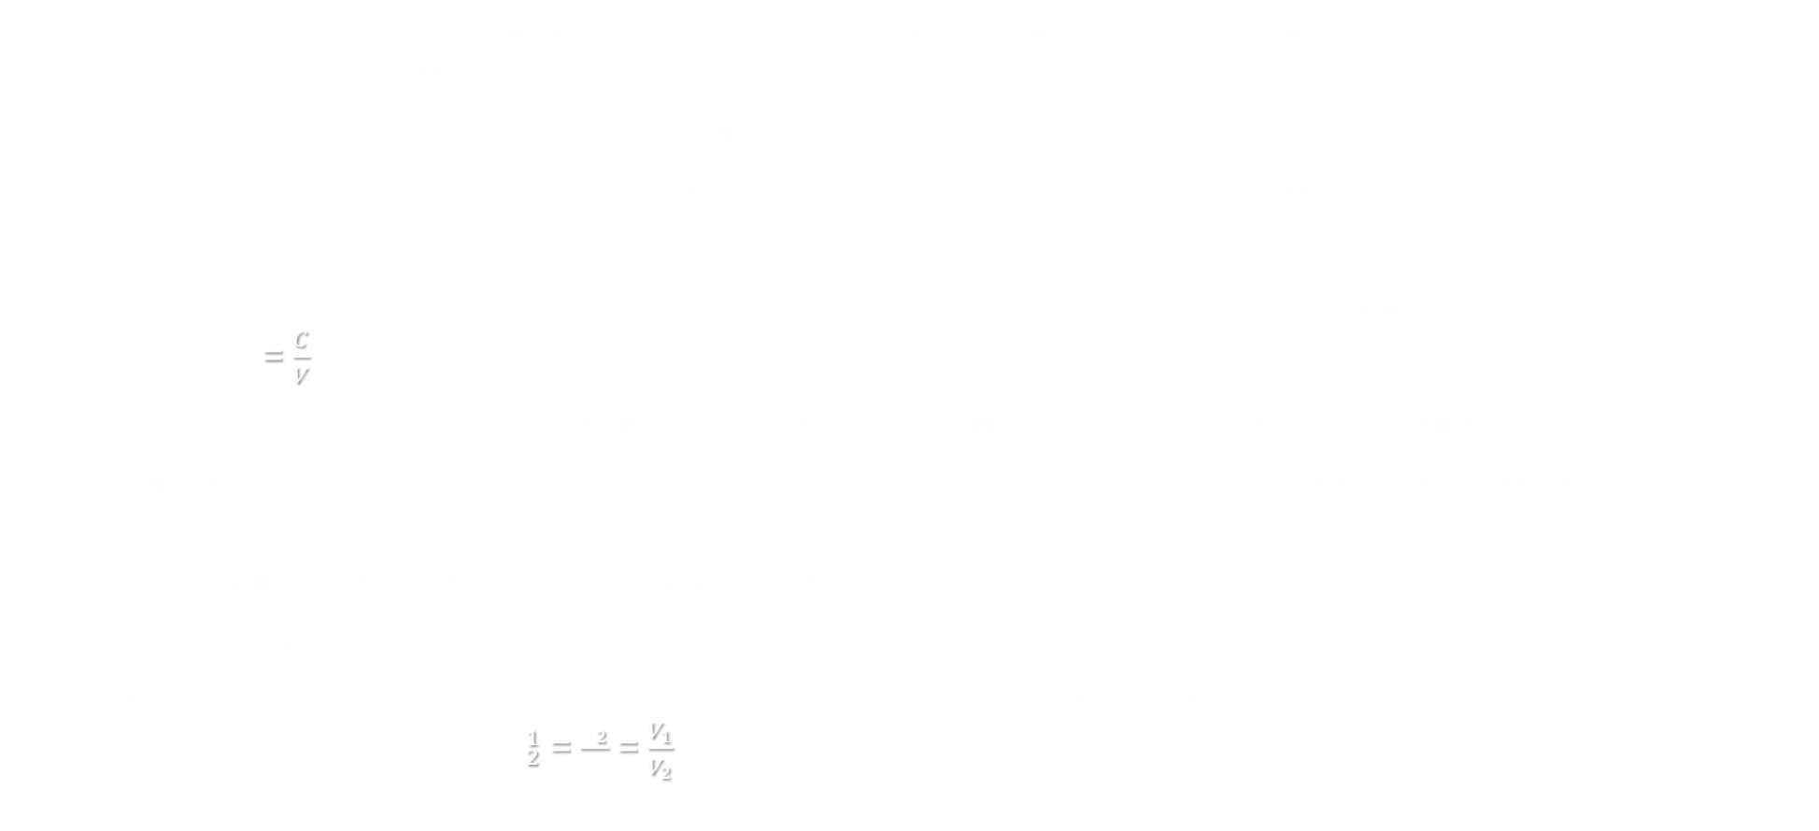
Refraction
If a ray of light comes to an interface between two media and enters into another medium of different refractive index, it changes itself suitable to that medium.
This phenomenon is defined as refraction of light
The extent to which these properties change is decided by the index of refraction, '$μ$’
Absolute refractive index:
Absolute refractive index of a medium is defined as the ratio of speed of light in vacuum to that in the given medium i.e. $μ$= $\frac{C}{V}$
As $μ$ is the ratio of same physical quantities, it is a unit less and dimensionless physical quantity
For any material medium (including air) n > 1, i.e., light travels fastest in vacuum than in any material medium
Medium having greater value of n is called optically denser
Relative refractive index:
Refractive index of medium 2 with respect to medium 1 is defined as the ratio of speed of light $V_{1}$ in medium 1 to its speed $V_{2}$ in medium 2, i.e. $μ_{2}^{1}$ = $\frac{μ_{2}}{μ_{1}}$ = $\frac{V_{1}}{V_{2}}$

Slide 14
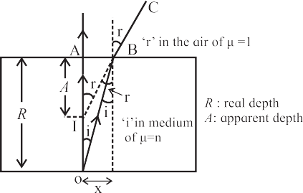

Illustrations of refraction
When seen from outside, the bottom of a water body appears to be raised. This is due to refraction at the plane surface of water
In this case, $μ_{water}= \frac{\text{Real} \text{depth}}{\text{apperant} \text{depth}}$
This relation holds good for a plane parallel transparent slab also as shown in fig.
a plane parallel slab of a transparent medium of refractive index n.
A point object O at real depth R appears to be at I at apparent depth A, when seen from outside (air)
Incident rays OA (traveling undeviated) and OB (deviating along BC) are used to locate the image
For small value of i and r, tan r = AB/A $≈$ sin r and tan i = AB/R $≈$ sin i
but $μ_{glass}= \frac{\text{sin} \text{r}}{\text{sin} \text{i}}$ = $\frac{\text{AB}\text{/}\text{A}}{\text{AB}\text{/}\text{R}}$ = $\frac{R}{A}$ = $\frac{\text{Real} \text{depth}}{\text{apperant} \text{depth}}$
2. A stick or pencil kept obliquely in a glass containing water appears broken as its part in water appears to be raised

Slide 15
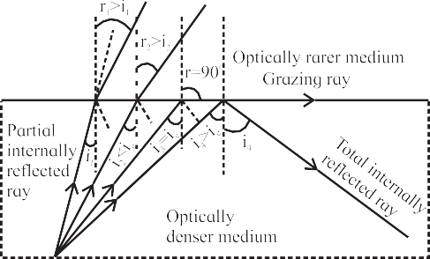

Total internal reflection
Figure shows refraction of light emerging from a denser medium into a rarer medium for various angles of incidence
The angles of refraction in the rarer medium are larger than the corresponding angles of incidence
At a particular angle of incidence $i_{c}$ (critical angle) in the denser medium, the corresponding angle of refraction in the rarer medium is 90
angles of incidence greater than $i_{c}$ , the angle of refraction become larger than 90⁰ and the ray does not enter into rarer medium at all but is reflected totally into the denser medium
This is called total internal reflection

Slide 16
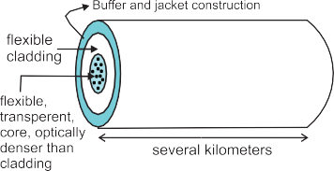
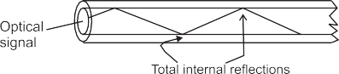
Applications of total internal reflection
Optical fiber : An optical fiber essentially consists of an extremely thin transparent, flexible core surrounded by optically rarer (smaller refractive index), flexible cover called cladding
This system is coated by a buffer and a jacket for protection
Entire thickness of the fiber is less than half a mm
Number of such fibers may be packed together in an outer cover
An optical signal (ray) entering the core suffers multiple total internal reflections as shown in fig. and emerges after several kilometers with extremely low loss travelling with highest possible speed in that material

Slide 17
Advantage of fibre optics
Broad bandwidth (frequency range): For TV signals, a single optical fibre can carry over 90000 channels (independent signals).
Immune to EM interference: Being electrically non-conductive, it is not able to pick up nearby EM signals.
Low attenuation loss: The loss is lower than 0.2 dB/km so that a single long cable can be used for several kilometers
Electrical insulator: No issue with ground loops of metal wires or lightning.
Theft prevention: It is does not use copper or other expensive material
Security of information: Internal damage is most unlikely

Slide 18
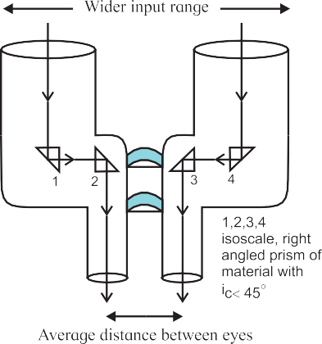

Prism binoculars
Binoculars using only two cylinders have a limitation of field of view as the distance between the two cylinders can’t be greater than that between the two eyes
This limitation can be overcome by using two right angled glass prisms ($i_{c}\sim {42}^{0})$ used for total internal reflection
Total internal reflections
occur inside isosceles, right angled prisms

Slide 19
Periscope
It is used to see the objects on the surface of a water body from inside water
The rays of light should be reflected twice through right angle. Reflections are similar to those in the binoculars and total internal reflections occur inside isosceles, right angled prisms

Slide 20
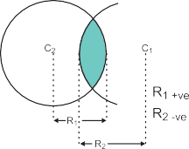
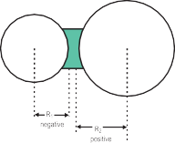

Refraction at a spherical surface and lenses
Refraction at a spherical surface will involve parameters including the curvature such as radius of curvature, in addition to refractive indices
Lenses: Lenses can be visualized to be consisting of intersection of two spheres of radii of curvature $R_{1}$ and $R_{2}$ or of one sphere and a plane surface (R = $∞$)
A lens is said to convex if it is thicker in the middle and narrowing towards the periphery
A lens is concave if it is thicker at periphery and narrows down towards center
For lenses of material optically denser than the medium in which those are kept, convex lenses have positive focal length and converge the incident beam while concave lenses have negative focal length and diverge the incident beam
For any thin lens $\frac{1}{f}$ = $\frac{1}{V}−\frac{1}{u}$
For number of thin lenses in contact with each other having common principal axis, Focal power of such combination is given by the algebraic addition (by considering ± signs) of individual focal powers i.e. $\frac{1}{f}$ = $\frac{1}{f_{1}}+\frac{1}{f_{2}}$+ $\frac{1}{f_{3}}$ …… => p = $p_{1}+p_{2}+p_{3}…….$
For two thin lenses, separated in air by distance d $\frac{1}{f}= \frac{1}{f_{1}}+\frac{1}{f_{2}}$ - $\frac{d}{f_{1}f_{2}}$ => p= $p_{1}+p_{2}$-d $p_{1}p_{2}$

Slide 21
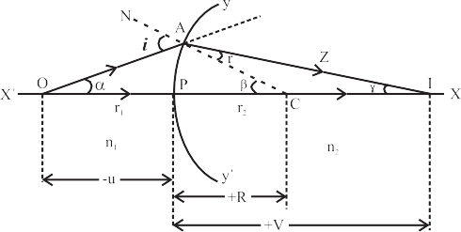

Refraction at a single spherical surface
Consider a spherical surface YPY’ of radius of curvature R, separating two transparent media of refractive indices $μ_{1}$ and $μ_{2}$ respectively with $μ_{1}$ < $μ_{2}$
P is the pole and X’PX is the principal axis
A point object O is at an object distance -u from the pole, in the medium of refractive index $μ_{1}$
To locate its image and in order to minimize spherical aberration, we consider two paraxial rays
Angle of incidence in the medium $μ_{1}$ at A is i
As $μ_{1}$ < $μ_{2}$the ray deviates towards the normal travels along AZ and cuts the principal axis at I
According to Snell’s law $μ_{1}\sin{i}=μ_{2}\sin{r}$ ………………(I)
Let $α, β and γ$be the angles subtended by incident ray, normal and refracted ray with the principal axis
$i= α+β$ and $β=r+ γ$ => $r$ = $β$- $γ$ …………………………(II)
As i and r is small for point object, hence, sin $i≈i and \sin{r}=r$
Thus , equation (i) become, $μ_{1}i=μ_{2}r$ ………………………….(III)
Similarly $α$ = $\frac{arc(AP)}{OP}$ = $\frac{arc(AP)}{−u}$ , $β$= $\frac{arc(AP)}{CP}$ = $\frac{arc(AP)}{R}$ and $γ=\frac{arc(AP)}{IP}$ = $\frac{arc(AP)}{V}$
Using this relation in (II)
$i= α+β$ = $\frac{arc(AP)}{−u}$ + $\frac{arc(AP)}{R}$ and $r$ = $β$- $γ$= $\frac{arc(AP)}{R}$ - $\frac{arc(AP)}{V}$
Using it in equation (III) , $μ_{1}\left(\frac{arc(AP)}{−u}\text{ + }\frac{arc(AP)}{R}\right)$ = $μ_{2}$ $\left(\frac{arc(AP)}{R}\text{ − }\frac{arc(AP)}{V}\right)$
$\left(\frac{μ_{1}}{−u} \text{+ }\frac{μ_{1}}{R}\right)$ = $\left(\frac{μ_{2}}{R}\text{ − }\frac{μ_{2}}{V}\right)$ => $\frac{μ_{2}}{R}$ - $\frac{μ_{1}}{R}$ = $\frac{μ_{2}}{V}$ - $\frac{μ_{1}}{u}$

Slide 22
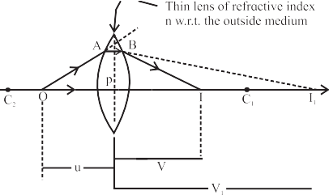
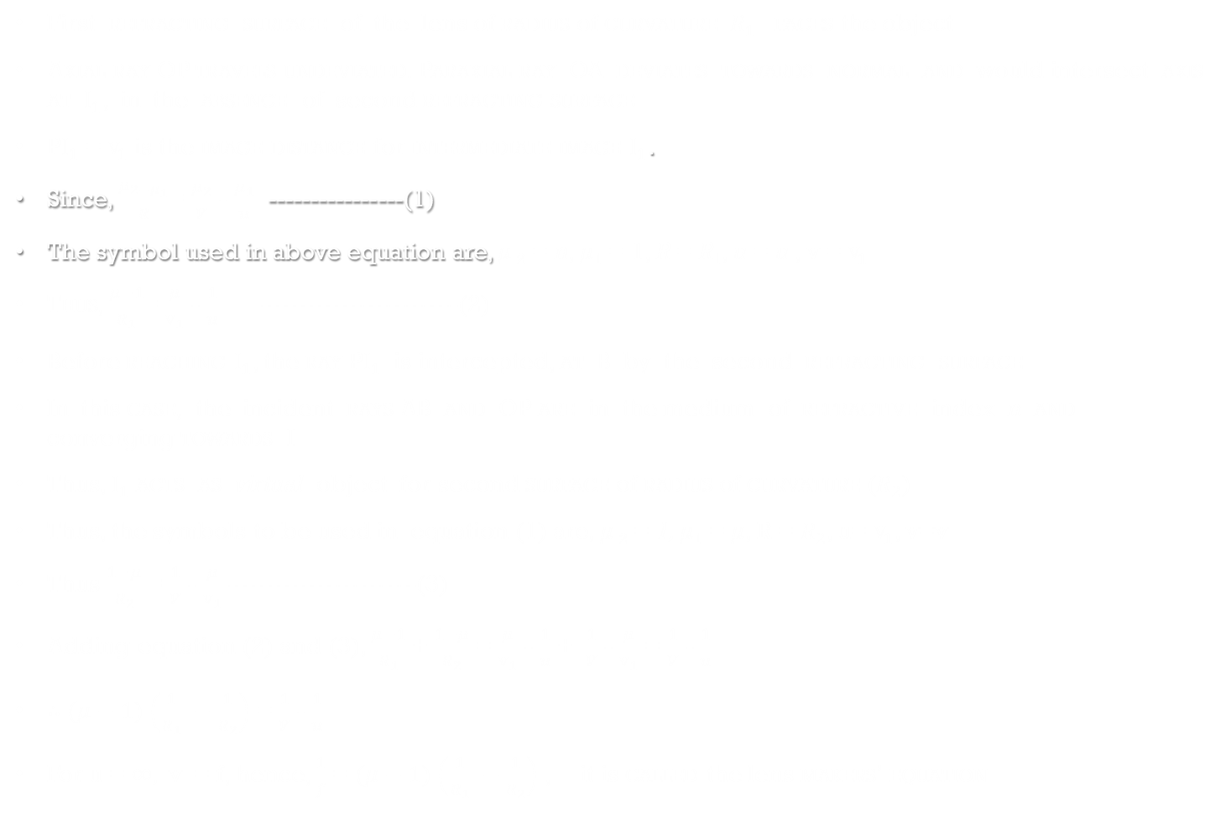

Lens makers’ equation
First refracting surface of the lens of radius of curvature $R_{1}$ faces the object
Axial ray OP travels undeviated. Paraxial ray OA deviates towards normal and would intersect axis at $I_{1}$, in the absence of second refracting surface
P$I_{1}$ = $v_{1}$ is the image distance for intermediate image $I_{1}$.
Since, $\frac{μ_{2−μ_{1}}}{R}$= $\frac{μ_{2}}{V}$ - $\frac{μ_{1}}{u}$ ----------------(1)
The symbol used in above equation are, $μ$₂ = n, $μ$₁ = 1, R = R₁, u = u , v = $v_{1}$
Thus, $\frac{μ−1}{R_{1}}$= $\frac{μ}{v_{1}}$ - $\frac{1}{u}$ -----------------------(2)
Before reaching $I_{1}$, the ray P$I_{1}$ is intercepted, at B by the second refracting surface
In this case, the incident rays AB and OP are in the medium of refractive index n and converging towards I
Thus, $I_{1}$ acts as virtual object for second surface of radius of curvature ($R_{2}$)
Thus, the symbols to be used in equation (1) are, $μ$₂ = 1, $μ$₁ = $μ$, R = $R_{2}$, u= $v_{1}$, v=v
Thus $\frac{1−μ}{R_{2}}$ = $\frac{1}{V}$ - $\frac{μ}{v_{1}}$ ----------------------(3)
Adding equation (2) and (3), $\frac{μ−1}{R_{1}}$ + $\frac{1−μ}{R_{2}}$ = $\frac{μ}{v_{1}}$ - $\frac{1}{u}$ + $\frac{1}{V}$ - $\frac{μ}{v_{1}}$ = $\frac{1}{V}$ - $\frac{1}{u}$
$∴(μ−1$) $\left(\frac{1}{R_{1}} −\frac{1}{R_{2}}\right)$ = $\frac{1}{V}$ - $\frac{1}{u}$
For u = $∞,$v = f, hence, $\frac{1}{f}$ = $(μ−1$) $\left(\frac{1}{R_{1}} −\frac{1}{R_{2}}\right)$ , it is called the lens makers’ equation
Consider a lens of radii of curvature $R_{1}$ and $R_{2}$ kept in a medium such that $μ$ is refractive index of material of the lens with respect to the outside medium.
Assuming the lens to be thin, P is the common pole for both the surfaces
O is a point object on the principal axis at a distance u from P

Slide 23
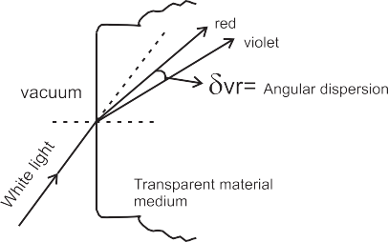
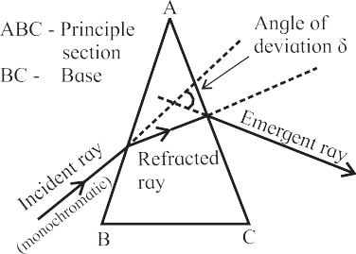
Angular Dispersion of light and prism
The appearance of color of light that is due to frequency of that ray (wave)
The refractive index of a material also depends upon the frequency of the wave and increases with frequency
As a result, for an obliquely incident ray, the angles of refraction are different for each colour and they separate (disperse) as they travel along different directions
This phenomenon is called angular dispersion
In order to have appreciable and observable dispersion, two parallel surfaces are not useful
In such case we use prisms, in which two refracting surfaces inclined at an angle are used
Prism: prism is having three rectangular surfaces forming a triangle
At a time two of these are taking part in the refraction
The one, not involved in refraction is called base of the prism
Principle section: Any section of prism perpendicular to the base is called principal section of the prism
Angle of deviation: The angle between path of incident ray and path of refracted or emergent ray is called angle of deviation

Slide 24
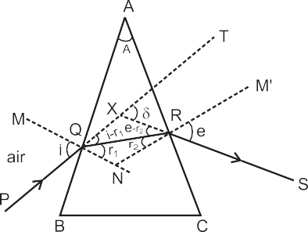

Refractive index of prism using angle of minimum deviation
Figure shows principal section ABC of a prism of absolute refractive index n kept in air.
Refracting surfaces AB and AC are inclined at angle A, which is refracting angle of prism or simply ‘angle of prism’
Surface BC is the base
A monochromatic ray PQ obliquely strikes first reflecting surface AB
Angle of incidence at Q is I
After refraction at Q, the ray deviates towards the normal and strikes second refracting surface AC at R which is the point of emergence
Angles of refraction at Q and R are $r_{1}$ and $r_{2}$respectively.
Angle TXS is angle of deviation $δ$
since, $<$AQN = $<$ARN = 90⁰
$∴$From quadrilateral AQNR, A + $<$QNR = 180⁰
From $∆$QNR, $r_{1}$ + $r_{2}$ + $<$QNR = 180⁰
$∴$ $r_{1}$ + $r_{2}$ ⁼ A ---------------------------------------------(1)
Angle $δ$ is exterior angle for triangle XQR, hence $<$XQR + $<$XRQ = $δ$
$∴$ (i - r₁ ) + (e - r₂ ) = $δ$
$∴$(i + e ) - (r₁ + r₂ ) = $δ$
Using equation (1) in above equation, (i + e ) - A = $δ$
Hence, ( i + e ) = $δ$ + A
n

Slide 25
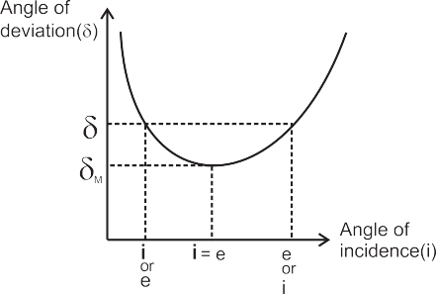
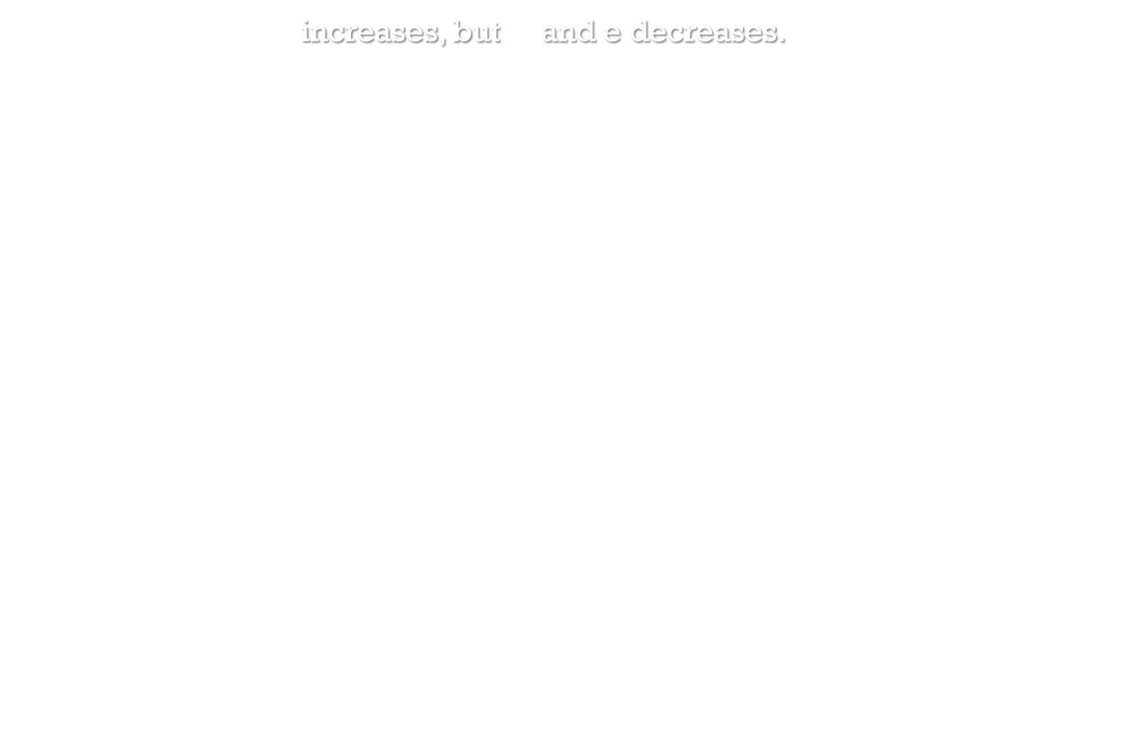
as i increases, $r_{1}$ increases, but $r_{2}$ and e decreases.
Graph shows that, with increasing values of i, the angle of deviation d decreases initially to a certain minimum ($δ_{m}$ ) and then increases
It is clear that except at $δ$ = $δ_{m}$ , (Angle of minimum deviation) there are two values of i for any given $δ$
By applying the principle of reversibility of light to path PQRS.
it is obvious that if one of these values is i, the other must be e and vice versa
Thus at $δ$ = $δ_{m}$ we have i = e.

Slide 26
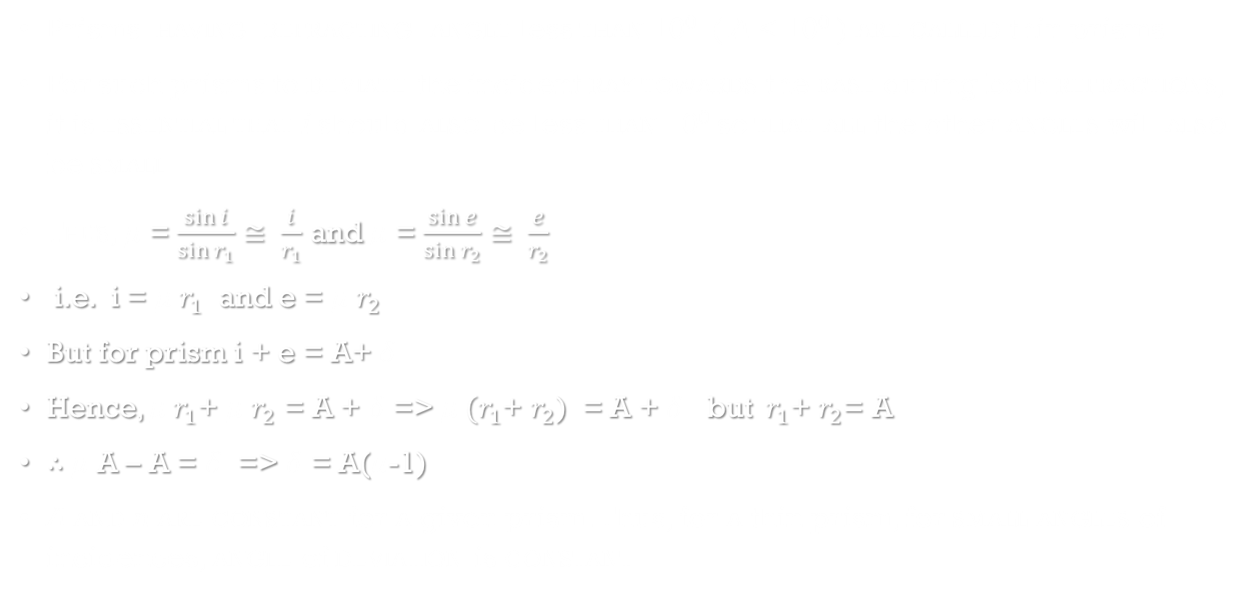
Thin prisms
Prisms having refracting angle less than 10⁰ ( A < 10⁰ ) are called thin prisms
For such prisms to deviate the incident ray towards the base during both refractions, it is essential that i should also be less than 10⁰ so that all the other angles will also be small
Thus, $μ$ = $\frac{\sin{i}}{\sin{r_{1}}}≅ \frac{i}{r_{1}}$ and $μ$ = $\frac{\sin{e}}{\sin{r_{2}}}≅ \frac{e}{r_{2}}$
i.e. i = $μ{ r}_{1}$ and e = $μ$ $r_{2}$
But for prism i + e = A+ $δ$
Hence, $μ{ r}_{1}$+ $μ$ $r_{2}$ = A + $δ$ => $μ{ (r}_{1}$+ $r_{2}$) = A + $δ$ but ${ r}_{1}$+ $r_{2}$= A
$∴$ $μ$ A – A = $δ$ => $δ$ = A($μ$-1)
A and n are constant for a given prism. Thus, for a thin prism, for small angles of incidences, angle of deviation is constant

Slide 27
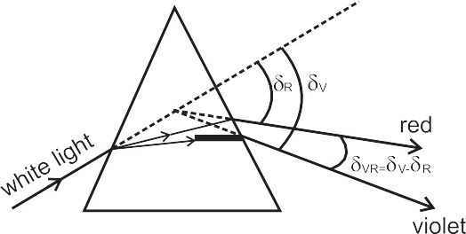
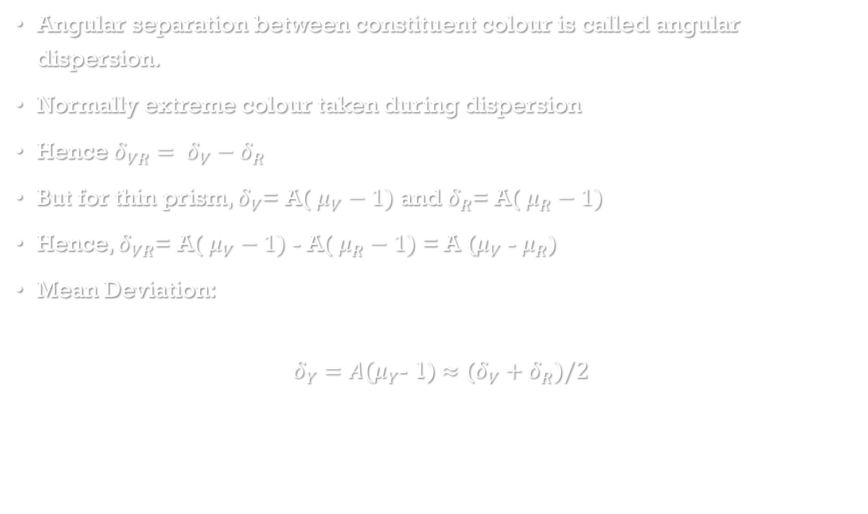
Angular dispersion and mean deviation
Angular separation between constituent colour is called angular dispersion.
Normally extreme colour taken during dispersion
Hence $δ_{VR}= δ_{V}−δ_{R}$
But for thin prism, $δ_{V}$= A( $μ_{V}−1)$ and $δ_{R}$= A( $μ_{R}−1)$
Hence, $δ_{VR}$= A( $μ_{V}−1)$ - A( $μ_{R}−1)$ = A ($μ_{V}$ - $μ_{R}$)
Mean Deviation: Yellow is practically chosen to be the mean colour for violet and red
Hence, mean deviation $δ_{Y}=A(μ_{Y}$- 1) $≈$ ($δ_{V}+δ_{R})/2$
n

Slide 28
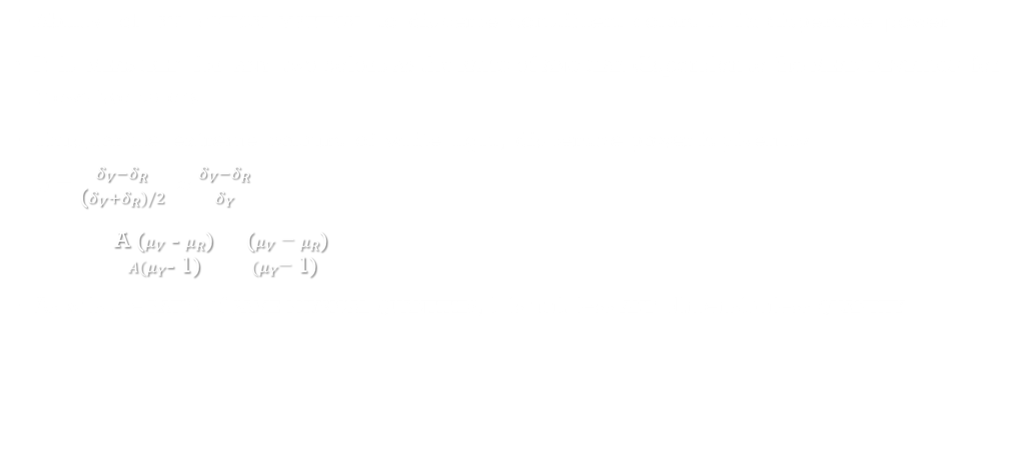
Dispersive power
Ability of an optical material to disperse constituent colors is its dispersive power
It is measured for any two colors as the ratio of angular dispersion to the mean deviation for those two colors
Thus, for the extreme colours of white light, dispersive power is given by $ω=\frac{δ_{V}−δ_{R}}{\text{(}δ_{V}+δ_{R})/2}$ $≈$ $\frac{δ_{V}−δ_{R}}{δ_{Y}}$
= $\frac{\text{A}\text{ (}μ_{V}\text{ − }μ_{R}\text{)}}{A(μ_{Y}\text{− 1)}}$ = $\frac{\text{ (}μ_{V}\text{ − }μ_{R}\text{)}}{(μ_{Y}\text{− 1)}}$
As w is the ratio of same physical quantities, it is unit less and dimensionless quantity

Slide 29
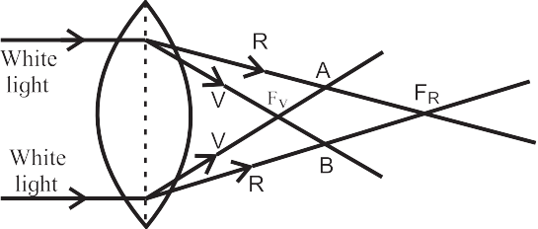
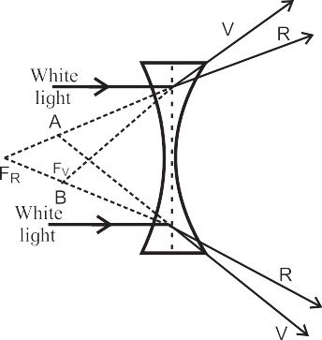
Chromatic aberration
lenses are prepared by using a transparent material medium having different refractive index for different colours. Hence angular dispersion is present
If the lens is thick, this will result into notably different foci corresponding to each colour for a polychromatic beam, like a white light
This defect is called chromatic aberration, violet being focused closest to pole as it has maximum deviation
Longitudinal chromatic aberration, transverse chromatic aberration and circle of least confusion are defined in the same manner as that of spherical aberration for spherical mirrors

Slide 30
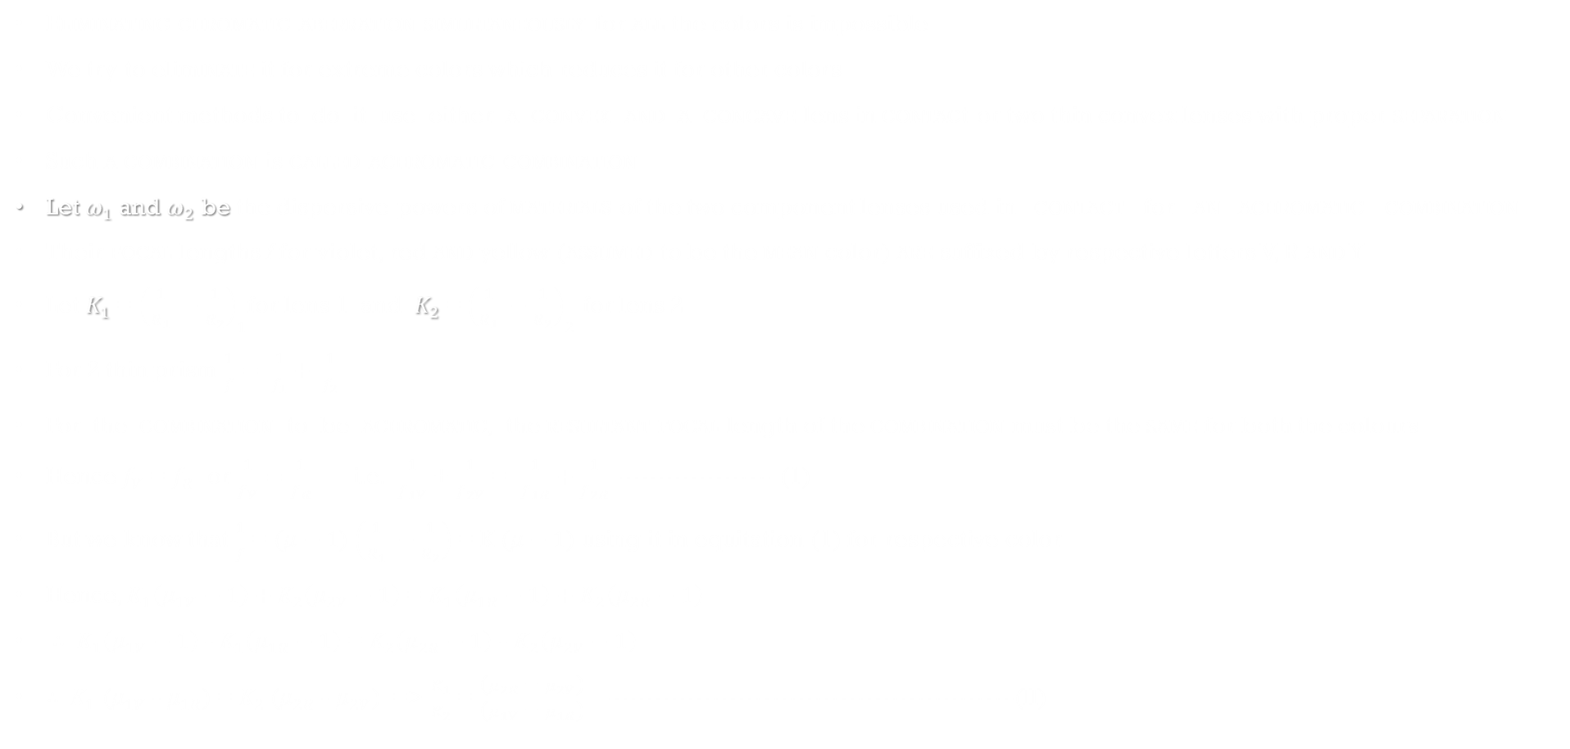
Reducing/eliminating chromatic aberration
Eliminating chromatic aberration simultaneously for all the colors is impossible
We try to eliminate it for extreme colors which reduces it for other colors
Convenient methods to do it use either a convex and a concave lens in contact or two thin convex lenses with proper separation
Such a combination is called achromatic combination
Let $ω_{1}$ and $ω_{2}$ be the dispersive powers of materials of the two component lenses used in contact for an achromatic combination
Their focal lengths f for violet, red and yellow (assumed to be the mean color) are suffixed by respective letters V, R and Y
Let $K_{1}$ = ${\left(\frac{1}{R_{1}} −\frac{1}{R_{2}}\right)}_{1}$for lens 1 and $K_{2}$ = ${\left(\frac{1}{R_{1}} −\frac{1}{R_{2}}\right)}_{2}$ for lens 2
For 2 thin prism $\frac{1}{f}= \frac{1}{f_{1}}+ \frac{1}{f_{2}}$
For the combination to be achromatic, the resultant focal length of the combination must be the same for both the colours
Hence $f_{V}$ = $f_{R}$ or $\frac{1}{f_{V}}=\frac{1}{f_{R}}$ i.e. $\frac{1}{f_{1V}}$ + $\frac{1}{f_{2V}}$ = $\frac{1}{f_{1R}}+\frac{1}{f_{2R}}$ ------------------ (1)
But we know that $\frac{1}{f}$ = $(μ−1$) $\left(\frac{1}{R_{1}} −\frac{1}{R_{2}}\right)$ = K $(μ−1$) using it in equitation (1) for respective color
Hence, $K_{1}\left(μ_{1V}−1\right)+$ $K_{2}\left(μ_{2V}−1\right)$ = $K_{1}\left(μ_{1R}−1\right)+$ $K_{2}\left(μ_{2R}−1\right)$
$∴$ $K_{1}\left(μ_{1V}−1\right)$ - $K_{1}\left(μ_{1R}−1\right)$ = $K_{2}\left(μ_{2R}−1\right)$ - $K_{2}\left(μ_{2V}−1\right)$
$∴$ $K_{1}$ ($μ_{1V}$ - $μ_{1R}$) = $K_{2}$ ($μ_{2R}$ - $μ_{2V}$) => $\frac{K_{1}}{K_{2}}$ = $\frac{\text{(}μ_{2R}\text{ − }μ_{2V}\text{)}}{\text{(}μ_{1V}\text{ − }μ_{1R}\text{)}}$ ------------------------------------------------(II)

Slide 31

for mean colour yellow, $\frac{1}{f_{y}}= \frac{1}{f_{1y}}+ \frac{1}{f_{2y}}$ with $\frac{1}{f_{1y}}$ = $K_{1}\left(μ_{1y}−1\right)$ and $\frac{1}{f_{2y}}$ = $K_{2}\left(μ_{2y}−1\right)$
Hence, $\frac{K_{1}}{K_{2}}$ = $\frac{\left(μ_{2y}−1\right)}{\left(μ_{1y}−1\right)}$ $×$ $\frac{f_{2y}}{f_{1y}}$ ----------(III)
Equating eqn (II) and (III) $\frac{f_{2y}}{f_{1y}}$ = $\frac{\text{(}μ_{2R}\text{ − }μ_{2V}\text{)}}{\text{(}μ_{1V}\text{ − }μ_{1R}\text{)}}$ $÷\frac{\left(μ_{2y}−1\right)}{\left(μ_{1y}−1\right)}$ = - $\frac{\text{(}μ_{2V} − μ_{2R}\text{)}}{\left(μ_{2y}−1\right)}$ $÷\frac{\text{(}μ_{1V}\text{ − }μ_{1R}\text{)}}{\left(μ_{1y}−1\right)}$ = $−\frac{ω_{2}}{ω_{1}}$
Equation (9.19) is the condition for achromatic
Dispersive power w is always positive. Thus, one of the lenses must be convex and the other concave

Slide 32
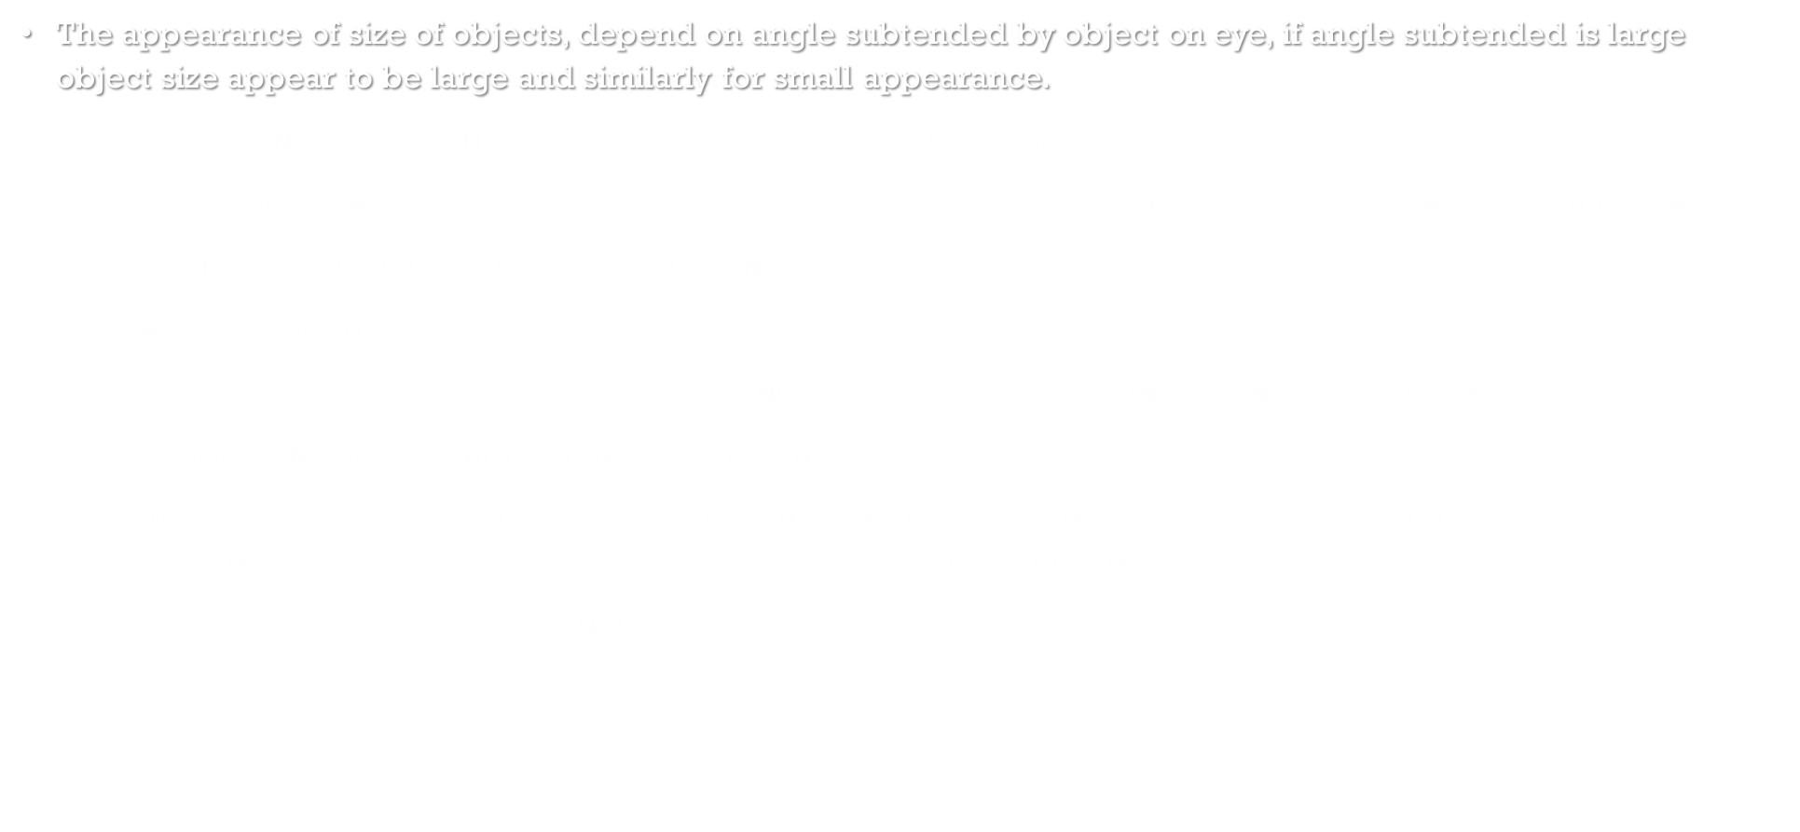
Optical instruments
The appearance of size of objects, depend on angle subtended by object on eye, if angle subtended is large object size appear to be large and similarly for small appearance.
Hence, apparent size of an object depends upon the visual angle subtended by the object from its position
Due to the limitation for focusing the eye lens it is not possible to take an object closer than a certain distance
This distance is called least distance of distance vision D
For a normal, human eye D = 25cm
Hence, optical instruments like, microscopes and telescopes help us in increasing the visual angle
This is called angular magnification or magnifying power
Magnifying power: the ratio of the visual angle made by the image formed by that optical instrument ($β$) to the visual angle subtended by the object when kept at the least distance of distinct vision ($α$ )
In the case of telescopes, $α$is the angle subtended by the object from its own position as it is not possible to get it closer

Slide 33


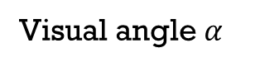
Simple microscope
You might have seen watch-makers using a special type of small convex lens while looking at very tiny parts of a wrist watch
Convex lens used for this purpose is a simple microscope
Fig 1 shows visual angle $α$ made by an object, when kept at the least distance of distinct vision D.
Fig 2 shows a convex lens forming erect, virtual and magnified image of the same object when placed within the focus
The visual angle $β$ of the object and the image in this case are the same
Hence the same object is now at a distance smaller than D
It makes $β$ greater then $α$ and the same object appears bigger.
magnifying power, in this case, is given by M=$\frac{visual angle of the image }{visual angle of object when placed at D}$ = $\frac{β}{α}$
For small angle of $α$ and $β$, M=$\frac{β}{α}$ $≈$ $\frac{tanβ}{tanα}$ = $\frac{D}{u}$
Visual angle $α$
Visual angle $β$

Slide 34
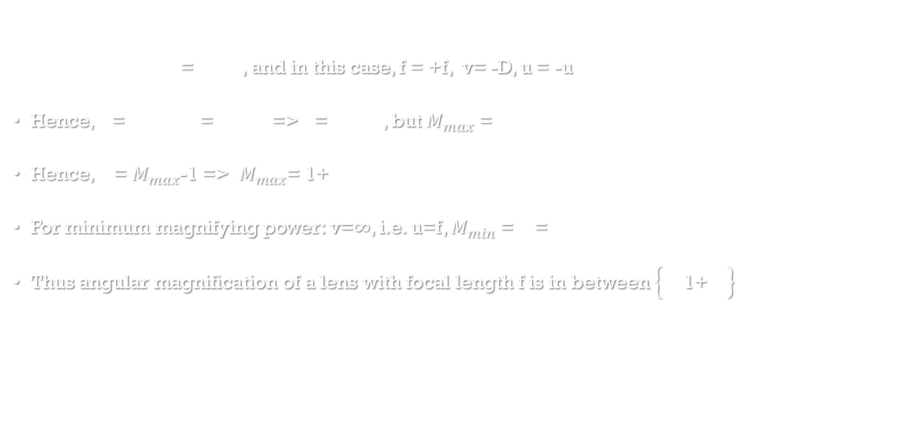
Limiting cases
For maximum magnifying power: the image should be nearest possible, i.e., at D
For a thin lens, $\frac{1}{f}$ = $\frac{1}{V}−\frac{1}{u}$, and in this case, f = +f, v= -D, u = -u
Hence, $\frac{1}{f}$ = $\frac{1}{−D}−\frac{1}{−u}$ = $\frac{1}{u}−\frac{1}{D}$ =>$\frac{D}{f}$ = $\frac{D}{u}−\frac{D}{D}$ , but $M_{max}$ = $\frac{D}{u}$
Hence, $\frac{D}{f}$ = $M_{max}$-1 => $M_{max}$= 1+ $\frac{D}{f}$
For minimum magnifying power: v=$∞$, i.e. u=f, $M_{min}$ = $\frac{D}{u}$ = $\frac{D}{f}$
Thus angular magnification of a lens with focal length f is in between $\left\{\frac{D}{f},\text{1+ }\frac{D}{f}\right\}$

Slide 35
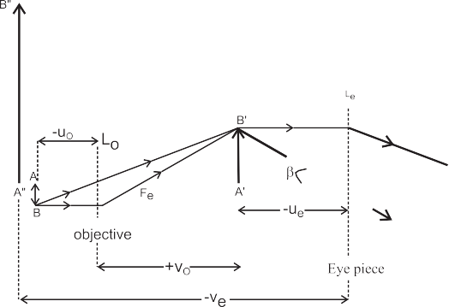
Compound microscope
The magnifying power of a simple microscope is inversely proportional to its focal length
But to make small focal length, thickness will increase which will cause chromatics aberration.
Hence to increase magnification more, need combination of lens
A compound microscope essentially uses two convex lenses of suitable focal lengths fit into a cylindrical tube with some adjustment possible for its length.
The smaller lens (~ 4 mm to 6 mm aperture) facing the object is called the objective
Other lens with which the observer see the object is called eye piece, has little aperture.
As shown in the Fig, a tiny object AB is placed between f and 2f of the objective which produces its real, inverted and magnified image A’ B’ in front of the eye lens.
Position of the eye lens is so adjusted that the image A’ B’ should form within its focus
Hence, for this object A’ B’, the eye lens behaves as a simple microscope and produces its virtual and magnified image A” B”, which is inverted with respect to original object AB

Slide 36
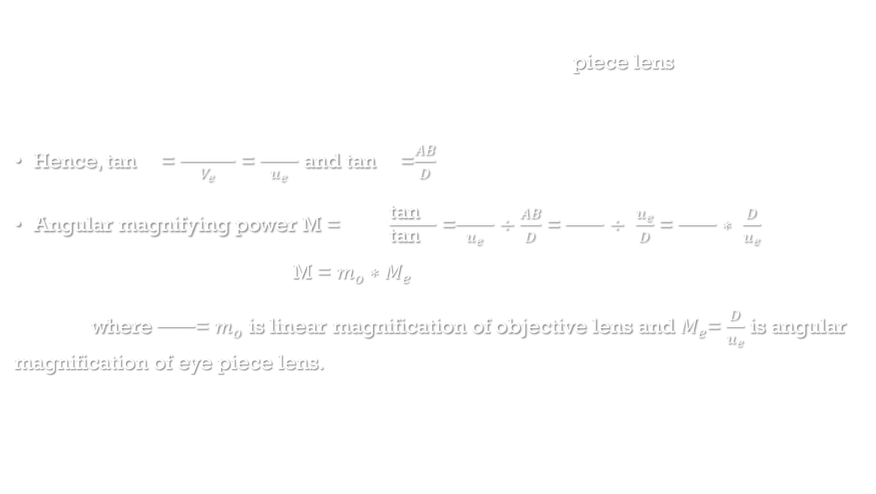
Magnifying power of a compound microscope:
the final image A” B” makes a visual angle $β$ at the eye piece lens
Visual angle made by the object from distance D is $α$
Hence, tan $β$ = $\frac{\text{A}\text{” }\text{B}\text{”}}{V_{e}}$ = $\frac{{\text{A}}^{′}B^{′}}{u_{e}}$ and tan $α$ =$\frac{AB}{D}$
Angular magnifying power M = $\frac{β}{α}$ $≈$ $\frac{\text{tan} β}{\text{tan} α}$ =$\frac{{\text{A}}^{′}B^{′}}{u_{e}}÷$ $\frac{AB}{D}$ = $\frac{{\text{A}}^{′}B^{′}}{AB}$ $÷$ $\frac{u_{e}}{D}$ = $\frac{{\text{A}}^{′}B^{′}}{AB}$ $∗$ $\frac{D}{u_{e}}$
M = $m_{o}∗M_{e}$
where $\frac{{\text{A}}^{′}B^{′}}{AB}$= $m_{o}$ is linear magnification of objective lens and $M_{e}$= $\frac{D}{u_{e}}$ is angular magnification of eye piece lens.
Length of the compound microscope then becomes L = distance between the two lenses $V_{o}$ + $u_{e}$

